Slide 1
<html>
Is there a Google Analytics cookie?
<javascript>
Google analytics measurement code
YES
NO
</javascript>
Returning visitor
New visitor
</html>

Slide 2

Google Analytics server call
GA server
Hit type
GA account
https://www.google-analytics.com/collect?v=1&t=pageview&tid=UA-123456-1&cid=123456789.123456789&dp=contact-page
Client ID
URL

Slide 3



Users (browsers)
Session
Page view
“Users” (humans)

Slide 4
Session
9:00
9:05
9:10
9:20
9:25
Page 1
Page 2
Page 3
Page 4
EXIT
New session
9:00
9:05
9:45
9:50
9:55
Page 1
Page 2
Page 3
Page 4
EXIT

Slide 5
Time measurement
9:00
9:05
9:10
9:20
9:25
Page 1
Page 2
Page 3
Page 4
EXIT
Session 1
20 minutes
New session
9:00
9:05
9:45
9:55
Session 2
5 minutes
Page 1
Page 2
Page 3
EXIT
Session 3
0 minutes

Slide 6
Page value
Page value
Page A
100$ / 2 sessions = 50$
Page A
Page B
Session 1
No conversion
Page B
100$ / 2 sessions = 50$
Page C
100$ / 1 session = 100$
Page A
Page B
Page C
Session 2
Conversion 100$

Slide 7
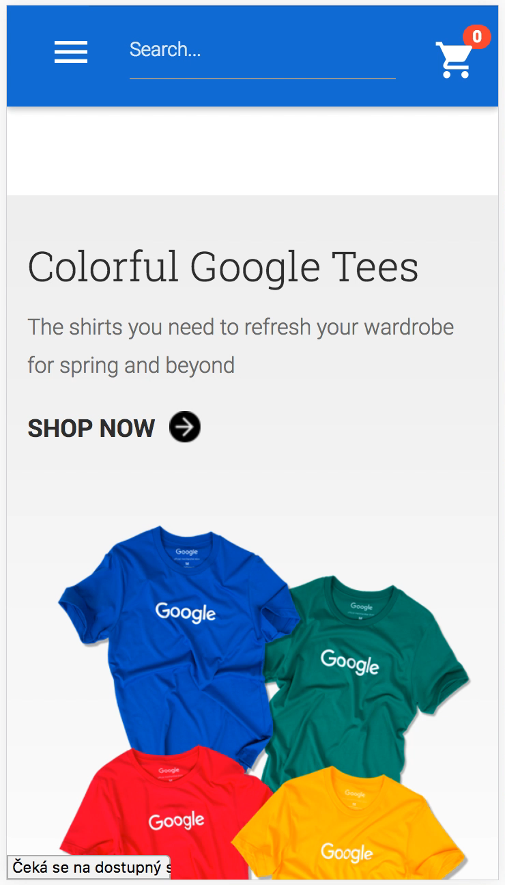
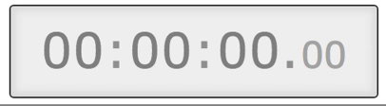

Slide 8
Distinguish traffic channels
https://pavelbrecik.cz/en/
https://pavelbrecik.cz/en/?utm_medium=cpc &utm_source=google &utm_campaign=ga-course

Slide 9
UTM parameters
utm_source |  | Domain, ad platform name
utm_medium |  | Ad type
utm_campaign |  | Campaign name
utm_content |  | Ad detail (creative, banner size)
utm_term |  | Keyword

Slide 10
Paid search
utm_source |  | Domain, ad platform name | google
utm_medium |  | Ad type | cpc
utm_campaign |  | Campaign name | ga-course
utm_content |  | Ad detail (creative, banner size) | benefits
utm_term |  | Keyword | google analytics course
https://pavelbrecik.cz/en/skoleni?utm_medium=cpc &utm_source=google &utm_campaign=ga-course &utm_content=benefits
&utm_term=google+analytics+course

Slide 11
Banners
utm_source |  | Domain, ad platform name | reddit
utm_medium |  | Ad type | banner
utm_campaign |  | Campaign name | ga-course
utm_content |  | Ad detail (creative, banner size) | 200x200
utm_term |  | Keyword
https://pavelbrecik.cz/en/skoleni?utm_medium=banner &utm_source=reddit &utm_campaign=ga-course &utm_content=200x200

Slide 12
Social network activity
utm_source |  | Domain, ad platform name | facebook
utm_medium |  | Ad type | post
utm_campaign |  | Campaign name | ga-course
utm_content |  | Ad detail (creative, banner size) | benefits-of-tagging
utm_term |  | Keyword
https://pavelbrecik.cz/en/skoleni?utm_medium=facebook &utm_source=post &utm_campaign=ga-course &utm_content=benefits-of-tagging

Slide 13
Newsletter
utm_source |  | Domain, ad platform name | newsletter
utm_medium |  | Ad type | email
utm_campaign |  | Campaign name | 2018-6-20
utm_content |  | Ad detail (creative, banner size) | ga-course
utm_term |  | Keyword
https://pavelbrecik.cz/en/skoleni?utm_medium=email &utm_source=newsletter &utm_campaign=2018-6-20 &utm_content=ga-course

Slide 14
Dos and don‘ts
Don‘t use diacritics
Use them consistently
Use „+“ if you want to have a blank space
Don‘t leave it emtpy (utm_medium=)
Use only small letters

Slide 15
source
medium
campaign
content
term
=
=
=
=
=
utm_source
utm_medium
utm_campaign
utm_content
utm_term
Tracking code loading
YES
Are UTMs or gclid in URL?
source
medium
campaign
content
term
=
=
=
=
=
domain name
organic
(not set)
(not set)
keyword
source
medium
campaign
content
term
=
=
=
=
=
(direct)
(none)
(not set)
(not set)
(not set)
Is it search a engine?
YES
NO
YES
NO
NO
Is there a referring domain?
source
medium
campaign
content
term
=
=
=
=
=
domain name
referral
(not set)
(not set)
(not set)

Slide 16
Traffic sources attribution
Date | Link type | Traffic source in Google Analytics
1.1.2018 | direct input | (direct) / (none)
1.3.2018 | newsletter | newsletter / email
13.3.2018 | reddit.com | reddit / referral
15.3.2018 | direct input | reddit / referral
15.10.2018 | direct input | (direct) / (none)

Slide 17
Keywords and search queries
Search queries
Keyword
Laptop bag
Blue bag
Large bag
School bag
Bags for kids
bag

Slide 18
Enhanced e-commerce
Product list view
Product
detail
Add to cart
Remove
from cart
Checkout
Purchase

